Slide 1
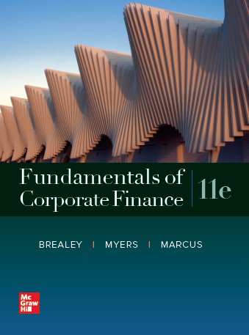
Fundamentals of Corporate Finance, 11th Edition
CHAPTER 6: Valuing Bonds
© McGraw Hill LLC. All rights reserved. No reproduction or distribution without the prior written consent of McGraw Hill LLC.

Slide 2
Topics Covered
6.1 The Bond Market
6.2 Interest Rates and Bond Prices
6.3 Yield to Maturity
6.4 Bond Rates of Returns
6.5 The Yield Curve
6.6 Corporate Bonds and the Risk of Default
Notes:
3
2
2
2
2
2

Slide 3
Bonds
Bond
Security that obligates the issuer to make specified payments to the bondholder
Debt Contract; Debt is less risky than Equity
Debt
“First in Line” to get paid
Equity
“Last in Line” to get paid
Notes:
3

Slide 4
Bonds
Bond
Security that obligates the issuer to make specified payments to the bondholder
Face Value (Par Value or Principal Value)
Payment at the maturity of the bond
Coupon
The interest payments made to the bondholder
Coupon Rate
Annual interest payment, as a percentage of face value
Notes:
3

Slide 5
Bonds
You need a 6.5% annual return to justify the risks of the following financial contract: you will receive annual payments of $50 for five years and one lump sum payment of $1,000 in five years. What price should you pay for the contract?
We calculated the price to be $937.66
Bond sells at a discount
“i” vs. “r”

Slide 6
Bonds i vs r
WARNING
The coupon rate IS NOT the discount rate used in the Present Value calculations
“ i” versus “ r”
The coupon rate merely tells us what cash flow the bond will produce
Since the coupon rate is listed as a %, this misconception is quite common
Notes:
5

Slide 7
Bond Prices
The price of a bond is the present value of all cash flows generated by the bond (i.e. coupons and face value) discounted at the required rate of return
cpn is commonly used as an abbreviation for coupon
Notes:
7

Slide 8
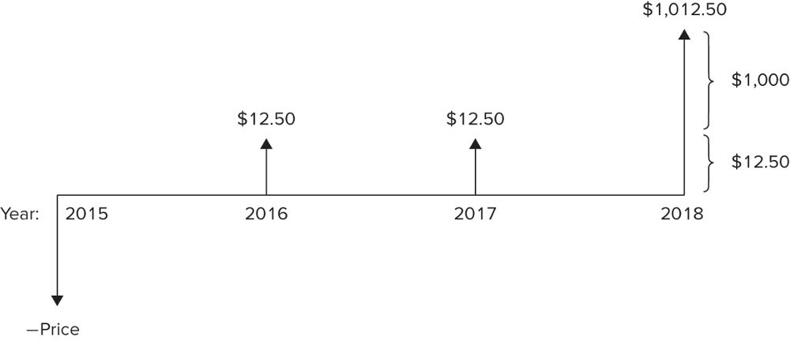
Bond Prices
Cash flows to an investor in the 1.25% coupon bond maturing in 2018

Slide 9
Bond Prices
Example
What is the price of a 1.25 % annual coupon bond, with a $1,000 face value, which matures in 3 years? Assume a required return of 1.194%.
Bond sells at a premium
Notes:
9

Slide 10
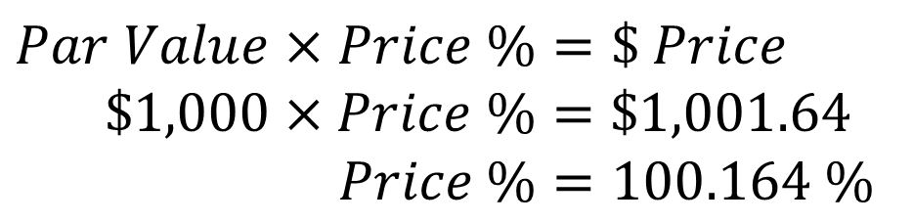
Bond Prices
Example (continued) Excel
What is the price of a 1.25 % annual coupon bond, with a $1,000 face value, which matures in 3 years? Assume a required return of 1.194%.
Bond prices are quoted as a percentage of par
$$Par Value×Price \%=\$ Price$$
$\$1,000×Price \%=\$1,001.64$
$$Price \%=100.164 \%$$
Notes:
9

Slide 11
Interest Rates and Bond Prices
Example
Q: How did the calculation change, given semi-annual coupons versus annual coupon payments?
Twice as many payments, cut in half, over the same time period.
$$$$
$$$$
$$$$
$$$$
$$
$$
$$
$$
$$
$$
$$
$$
Notes:
14

Slide 12
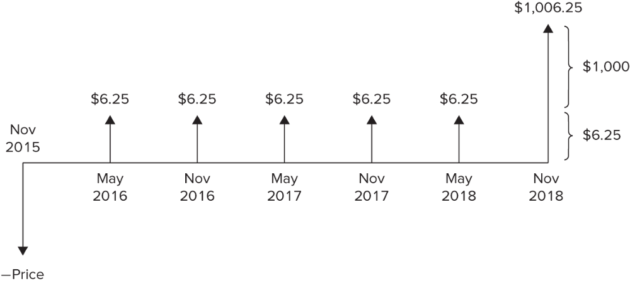
Interest Rates and Bond Prices
Cash flows to an investor in the 1.25% coupon bond maturing in 2018. The bond pays semiannual coupons, so there are two payments of $6.25 each year.

Slide 13
Interest Rates and Bond Prices (10 of 17)
Example (continued) Excel
What is the price of the bond if the required rate of return is 0.597% AND the coupons are paid semi-annually?
Price % = 100.165%
Notes:
13

Slide 14
Bond Prices
Cash flows to an investor in the 1.25% coupon bond maturing in 2018 Excel

Slide 15
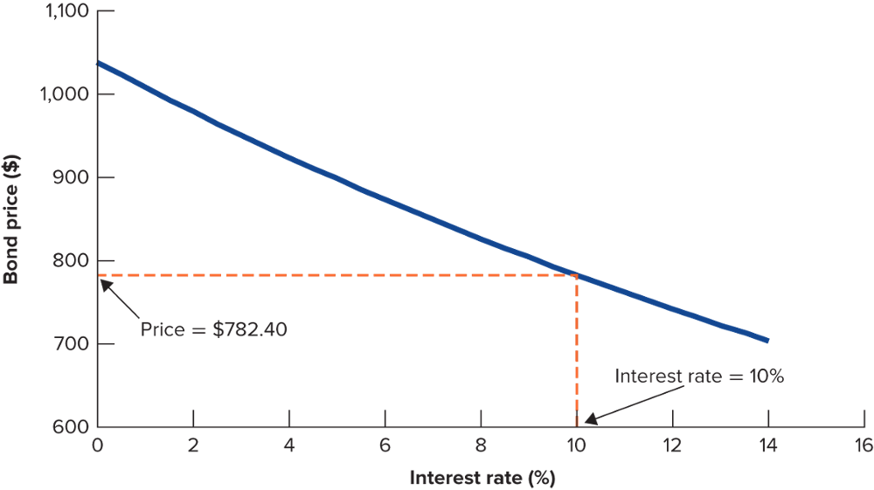
Interest Rates and Bond Prices
The value of the 1.25% bond falls as interest rates rise; 3- year Bond with annual payments if r skyrockets to 10%

Slide 16
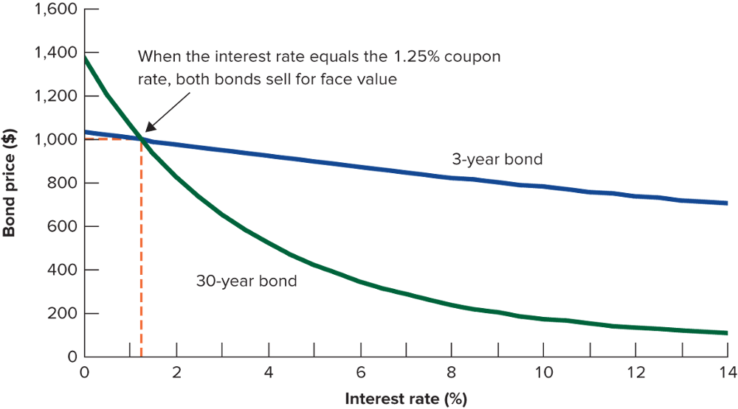
Interest Rates and Bond Prices Interest Rate Risk
Different maturity bonds have different interest rate risk

Slide 17
Interest Rate Risk
3-yr Bond vs. 30-yr Bond; both i = 1.25%
What is price if r = 1.25%? $1,000 (100%)
What happens if r increases to 2%?
Do 3-yr Bond:
PV function: .02 Rate, 3 NPER, 12.50 PMT 1,000 FV
$978.37 (97.84%)
Notes:
21

Slide 18
Interest Rate Risk
3-yr Bond vs. 30-yr Bond; both i = 1.25%
What is price if r = 1.25%? $1,000 (100%)
What happens if r increases to 2%?
Now do 30-yr Bond:
PV function: .02 Rate, 30 NPER, 12.50 PMT 1,000 FV
$832.03 (83.20%)
Notes:
21

Slide 19
Interest Rate Risk
3-yr Bond dropped from $1,000 to $978.37
30-yr Bond dropped from $1,000 to $832.03
Conclusion: The longer the Maturity, the greater
the Interest Rate Risk (Interest Rate Risk also called Maturity Risk); the greater the Risk, the higher the required return
Notes:
21

Slide 20
The Yield Curve (1 of 2)
Term Structure of Interest Rates
A listing of bond maturity dates and the interest rates that correspond with each date
Yield Curve
Plot of relationship between Treasury bond yields to maturity and time to maturity (generally upward sloping because longer maturities pose greater Interest Rate Risk)
Notes:
26

Slide 21
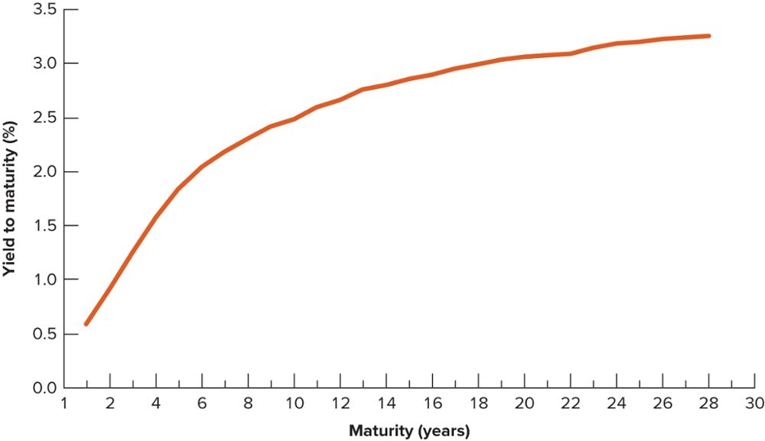
The Yield Curve (2 of 2)
Treasury strips are bonds that make a single payment. The yields on Treasury strips in November 2015 show that investors received a higher yield on longer term bonds.

